Slide 1

ML 101 Course
Arush Garg
AI and Machine Learning Club
Overseas Family School

Slide 2

Course (bit.ly/ML_101)
Introduction to Machine Learning (ML)
Regression
Core ML Concepts
Classification
Decision Trees
Model selection and tuning
Unstructured data: Text
Neural Networks
Unstructured data: Images
Introduction to Deep Learning
Beyond Regression & Classification
Notes:
Welcome back to ML 101 course. In today’s lesson we will cover multiple core ML concepts.

Slide 3
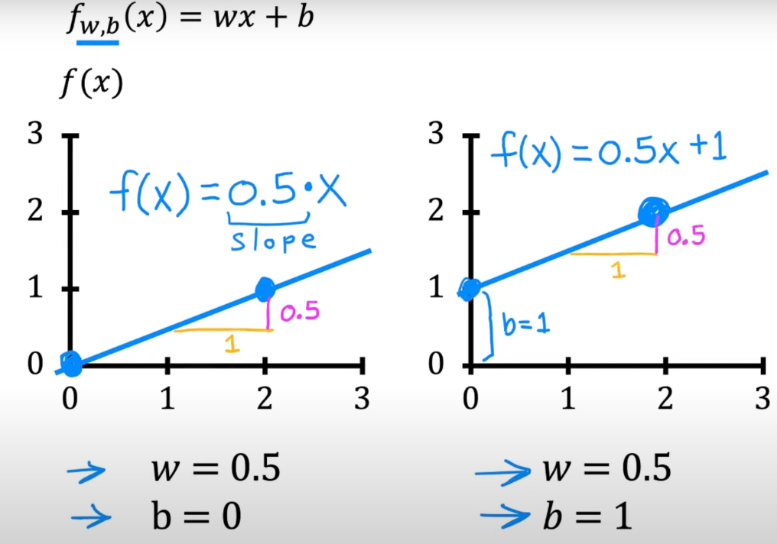

Recap
Supervised learning
train a computer by feeding in data with right answers, so it can learn to give correct answers for new inputs it hasn't seen before.
Linear Regression
Simplest ML model, represented as “wx + b”
Training objective: figure out the values of ‘w’ and ‘b’ such that it is able to make predictions using “wx + b” equation with high accuracy for all values of x
high accuracy = low RMSE
We can add additional features like “x²”, “x³” to capture non-linear relationship between x and y while still using Linear Regression model
Data reduction and Cleaning
Garbage in, Garbage out
Dimensionality reduction (fewer columns), Sampling (fewer rows), Data Cleaning (handling missing values, outliers, bad data)
Notes:
First a quick recap. Supervised learning is a type of machine learning where we feed data with right answers. Linear Regression is one example of supervised learning algorithm. If there is only one input feature, Linear Regression is simply a line equation wx+b. As part of model training we need to figure out the values of ‘w’ and ‘b’ such that we can make accurate predictions on unseen data.
Given that machine learning is all about finding patterns in training data, if our data is noisy, biased or incorrect, our model quality will suffer because of that. We can use various data cleaning techniques to improve the quality of our data, resulting in better quality models.

Slide 4
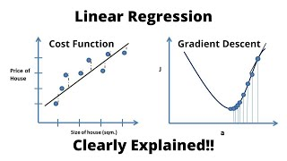
Introduction to Cost function & Gradient Descent Algorithm
This video uses following equation for univariate linear regression
y = a₀ + a₁x
Earlier we used
y = wx + b
This is just a notation difference, such that
a₀ = b and a₁ = w
Same holds true for the multivariate version of this equation
Priyanshu Vats on Youtube [link]
Notes:
In this video we will learn how does Linear Regression algorithm figures out the parameter values that best fit the training data?
(click to play the video)

Slide 5

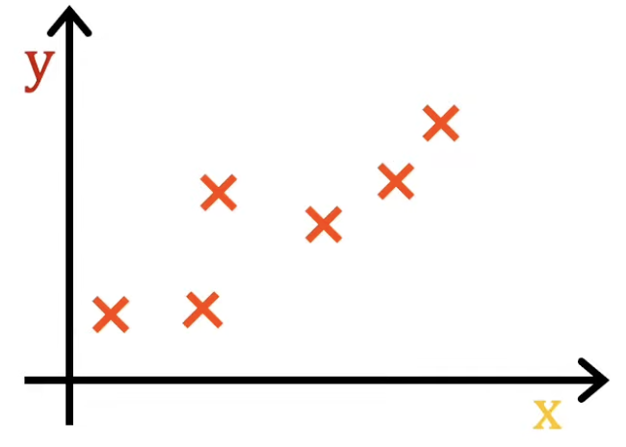
Cost function = (½ * RMSE) (mean square error)
a₀ = b and a₁ = w
All these 3 lines have HIGH COST
For blue line COST is LOW
Notes:
As you might have guessed, the cost function of Linear Regression model is very similar to the RMSE metric we talked about in the last lesson. As we are not taking the under-root here and dividing by “2”, it is half of Mean Square Error or MSE.
The cost function J is a function of the model parameters.
In the left diagram, all 3 lines are poor fit to the data and hence the cost J would be high. In the right diagram the blue line is a good fit to the data and hence the cost J would be low.

Slide 6
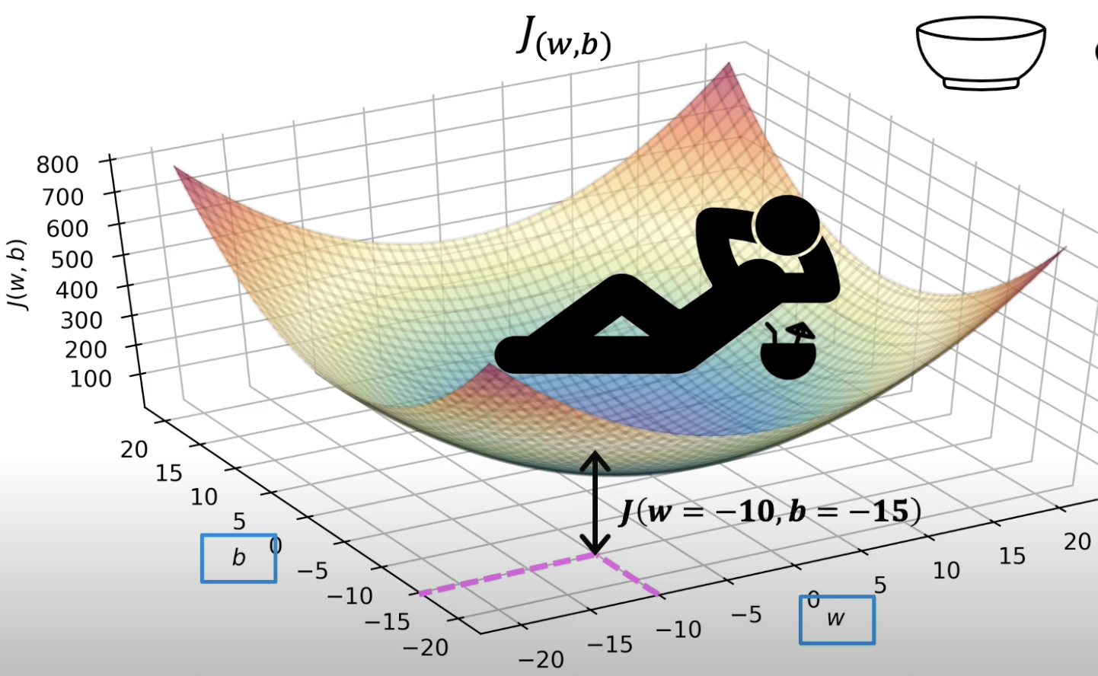
Gradient Descent Algorithm (recap)
Initialize (b, w) with some random value and calculate the cost function J ( )
Calculate the value of the slope in each direction, i.e., b and w
Based on the slope, adjust the value of b and w to take a step down the slope ( )
Changing ‘b’ & ‘w’ results in a new line, hence new cost value
Repeat steps 2 and 3 as long as the cost is decreasing
Beyond a point ( ) either the cost function will stop decreasing or the amount of decrease will be negligible. We can stop the training process at this point
The resulting (b, w) represent the weights of the “learnt” model and will be used to make predictions using “wx+b” equation (x = input).
Cost function of Linear Regression is like a hammock, so finding (b,w) corresponding to minimum cost (lowest point) is like walking down the slope, one step at a time.
Same is true for multivariate Linear Regression cost function as well.
Notes:
When we plot the function J with ‘b’ and ‘w’ as the two dimensions, it looks like a hammock or a soup bowl.
In order to find the minimum point, we simply need to start from any random point and keep walking down the slope.
(click)
Let’s say we pick some random value of ‘b’ and ‘w’ such that the cost is “blue dot” (click)
We will calculate the value of slope in each direction and update the values of b & w such that we start walking down the slope (click)
We repeat this process till we reach the minimum. (click, click)
The resulting ‘b’ and ‘w’ are what we will use to make all future predictions.

Slide 7
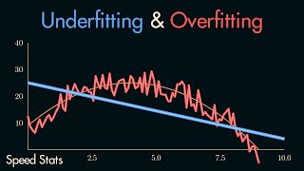
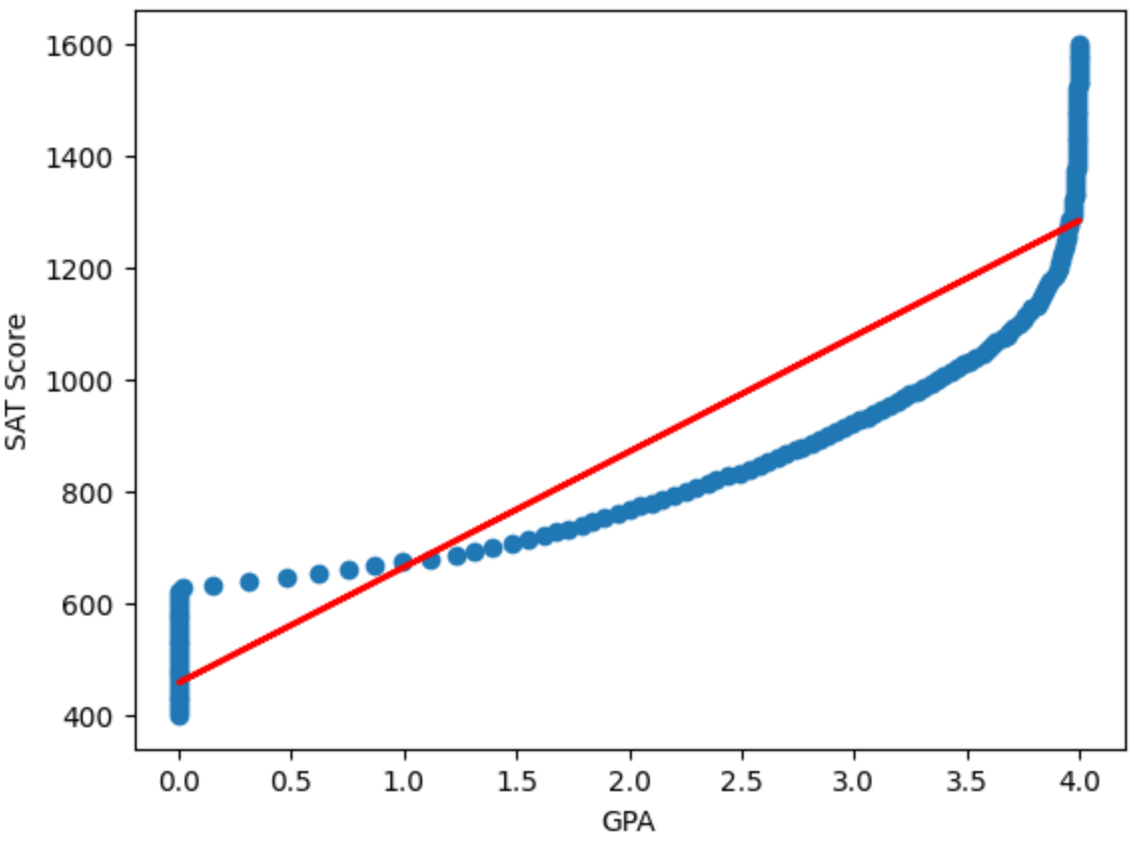
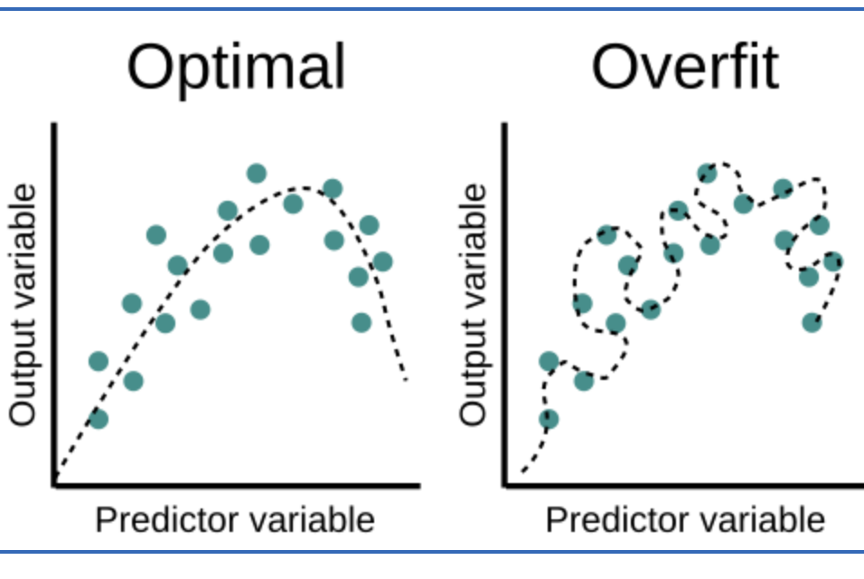
Underfitting / Overfitting
Underfitting
NStatum on Youtube [link]
Notes:
(click to play the video)
(after the video)
In our first lesson we trained a linear regression model that was clearly an underfit to the data and hence both the training and test errors were very high.
In case of over-fitting you will observe that the training error is very low whereas the test error is very high. This is bad as our objective is to learn the pattern from the training data, not to memorize it.

Slide 8
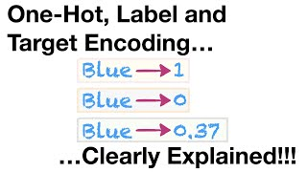
Feature Engineering: Handling non-numerical data
y = wx + b; how will this math equation work for “school name” feature?
Categorical variables
One-Hot Encoding creates one new boolean feature for every unique value of the categorical variable.
Some ML algorithms, like Decision Trees, can handle categorical data without the need to apply One-Hot Encoding.
StatQuest with Josh Starmer
Notes:
(click to play the video)
(after the video - click)
In case of Linear Regression model, all feature values MUST be numeric. Hence for categorical variables with 2 unique values we use boolean encoding and with 3 or more values we use One hot encoding. One hot encoding creates one new boolean feature for every unique value of the categorical variable.

Slide 9

Hands-on Exercises
Lesson 3 / NonNum.ipynb
https://github.com/techno-nerd/ML_101_Course/blob/main/03%20Core%20Concepts/NonNum.ipynb
Notes:
For this lesson’s exercise, check out NonNum.ipynb. This file cleans the data for a Grades Prediction problem and saves a clean csv file, which can be used for model training.
The link to the repo can be found in the description below

Slide 10
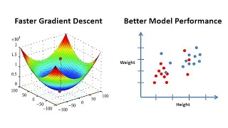

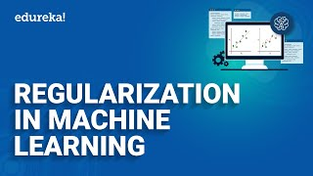
Further Reading / Watching / Doing
NonNum.ipynb
Relevant Article
Feature Scaling by Priyanshu Vats on Youtube [link]
Regularization is an important concept when it comes to avoiding overfitting
Different types of encoding by StatQuest with Josh Starmer
Edureka on YouTube [link]
Notes:
To learn more, check out these videos about Feature Scaling, the different types of encoding and regularisation.

Slide 11
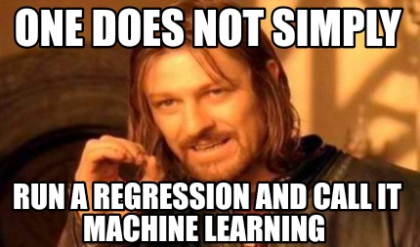
Agenda for next class
Introduction to classification
Logistic Regression
Name is misleading, it’s actually a classification model
Multi-class classification
Eval metrics for classification
Confusion Matrix
Notes:
In the next lesson, we will tackle classification problems using Logistic Regression.

